Slide 1
CSG2C3/ Interaksi Manusia dan Komputer (IMK)
Tim Dosen IMK
KK SIDE
THE USER INTERFACE (UI) DESIGN PROCESS
Step 1 : Know Your Users & Clients

Slide 2
Tujuan
Setelah mengikuti materi ini mahasiswa dapat:
Memahami pentingnya mengenal pengguna dari aplikasi yang akan dibangun sebagai dasar untuk merancang antarmuka perangkat lunak
Mendefinisikan Persona User antarmuka perangkat lunak

Slide 3
Step 1 : Know your users and clients
Understand how people interact with computers.
Understand the human characteristics important in design.
Identify the user’s level of knowledge and experience.
Identify the characteristics of the user’s needs, tasks, and jobs.
Identify the user’s psychological characteristics.
Identify the user’s physical characteristics.
Employ recommended methods for gaining understanding of users.

Slide 4
Output Step 1
Adapun output dari step 1 ini adalah menghasilkan Persona User
Persona User dibuat untuk :
Help identify specific users and needs
Identify primary, secondary users
Helps choose the right individuals to design for

Slide 5
Understand how people interact with computers
Siklus aksi manusia :
Tujuan dibentuk
Sebuah rencana eksekusi disusun dan diimplementasikan
Hasil dari sebuah tindakan kemudian dievaluasi
Mengapa orang memiliki masalah dengan komputer
Terlalu banyak flesibilitas
Menggunakan jargon
Desain yang membingungkan/tidak jelas
Perbedaan yang terlalu halus
Disparitas dalam strategi pemecahan masalah

Slide 6
Understand the human characteristics important in design
Respon psikologis yang khas untuk desain buruk adalah: Kebingungan, Annoyance, Frustrasi, Panic / stres, Kebosanan.
Kemudian akan diikuti dengan reaksi fisik :
Pengabaian sistem.
Penggunaan sebagian dari sistem.
Penggunaan langsung dari sistem.
Modifikasi tugas.
Aktivitas kompensasi.
Penyalahgunaan sistem.
Pemrograman langsung

Slide 7
Understand the human characteristics important in design
Perception
Memory : Short term memory (STM) dan Long term memory (LTM)
Sensory storage
Visual Acuity
Foveal and Peripheral Vision
Information Process
Mental Models
Movement Control
Learning
Skill
Performance Load
Individual Differences

Slide 8
Understand the human characteristics important in design
Faktor penentu utama untuk merancang sistem interaktif
Pemahaman bagaimana orang berpikir, belajar dan berkomunikasi
Bisa dianalogikan dengan model pemrosesan dalam komputer

Slide 9
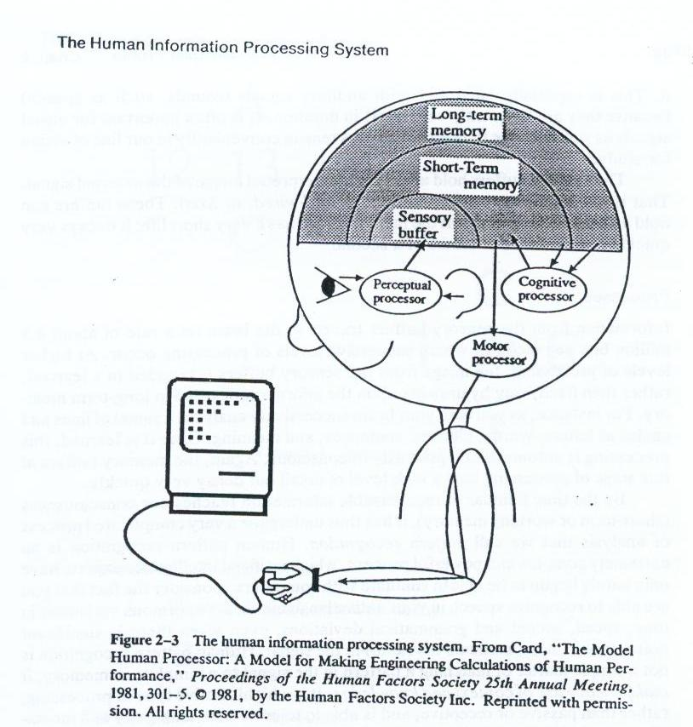
3 Phase Human Information Processing System
Perceptual System (Read – scan)
Cognitive System (Think)
Motor System (Response)

Slide 10
Perceptual System
Memory Structure :
Sensory organ → sensory buffer to hold a virtual, uninterpreted image of external signal
Can hold a high level of detail, but a very short in duration
Information will decay or travel to brain

Slide 11
Perceptual Process
Image from sensory buffer is recorded in a learned way by drawing upon the information store in long-term memory
Human Pattern Recognition is not a simple matter of matching a pattern it makes heavy use of context and knowledge
Human Pattern Recognition is a active processing, able to tolerate an ambiguity and incompleteness information.

Slide 12
Cognitive System
Short-term Memory (STM) :
Not only a storage buffer but also a (very slow) processor
Limited in Capacity and Duration
Long Term Memory (LTM) :
Unlimited in Capacity and permanent duration
Request effort & concentration to put new information in LTM

Slide 13
Motor System
It is believe that thought is translated into action through a series of discrete micromovement
Motor movement relevant to UI design include :
head, eye, arm, hand and finger movement

Slide 14
Human Considerations in the Design of Business Systems
The User’s Knowledge and Experience
The User’s Tasks and Needs
The User’s Psychological Characteristics
The User’s Physical Characteristics

Slide 15
Identify the user’s level of knowledge and experience
KNOWLEDGE/EXPERIENCE
Computer Literacy | Highly technical or experienced, moderate computer experience, or none.
System Experience | High, moderate, or low knowledge of a particular system and its methods of interaction.
Application Experience | High, moderate, or low knowledge of similar systems.
Task Experience | Level of knowledge of job and job tasks.
Other Systems Use | Frequent or infrequent use of other systems in doing job.
Education | High school, college, or advanced degree.
Reading Level | Less than 5th grade, 5th–12th, more than 12th grade.
Typing Skill | Expert (135 WPM), skilled (90 WPM), good (55 WPM), average (40 WPM), or “hunt and peck” (10 WPM).
Native Language or Culture | English, another, or several.

Slide 16
Identify the characteristics of the user’s needs, tasks, and jobs
JOB / TASK / NEED
Type of System Use | Mandatory or discretionary use of the system.
Frequency of Use | Continual, frequent, occasional, or once-in-a-lifetime use of system.
Task or Need Importance | High, moderate, or low importance of the task being performed.
Task Structure | Repetitiveness or predictability of tasks being automated, high, moderate, or low.
Social Interactions | Verbal communication with another person required/not required.
Primary Training | Extensive or formal training, self-training through manuals, or no training.
Turnover Rate | High, moderate, or low turnover rate for jobholders.
Job Category | Executive, manager, professional, secretary, clerk.
Lifestyle | For Web e-commerce systems, includes hobbies, recreational pursuits, and economic status.

Slide 17
Identify the user’s psychological characteristics
PSYCHOLOGICAL CHARACTERISTICS
Attitude | Positive, neutral, or negative feeling toward job or system.
Motivation | Low, moderate, or high due to interest or fear.
Patience | Patience or impatience expected in accomplishing goal.
Expectations | Kinds and reasonableness.
Stress Level | High, some, or no stress generally resulting from task performance.
Cognitive Style | Verbal or spatial, analytic or intuitive, concrete or abstract.

Slide 18
Identify the user’s physical characteristics
PHYSICAL CHARACTERISTICS
Age | Young, middle aged, or elderly.
Gender | Male or female.
Handedness | Left, right, or ambidextrous.
Disabilities | Blind, defective vision, deafness, motor handicap.

Slide 19
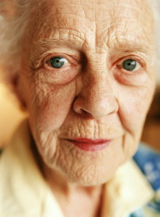
An Example Persona : Marjorie Bannet
Biography
78 years old
Just moved to Penrith from Windermere
Has a son in Hastings, and a daughter in Newcastle
Doesn’t know anyone else in Penrith yet
Hasn’t been driving for a few years now
Sometimes feels lonely
Has a help come in once a week
Would like to be able to read more

Slide 20
An Example: Marjorie Bannet
Health
Has trouble sleeping from time to time. Will wake up in the early hours and often not get to sleep again for 2-3 hours
A little arthritis in her hands
Early cataracts, so less acute vision
Can move about, perhaps not quite as quickly as she could 10 years ago
Sometimes has a rest in the afternoon

Slide 21
An Example: Marjorie Bannet
Technology
Has never used a computer before, and is a little nervous about them
Has a mobile phone, and instructions on how to use it from her son
Uses the microwave to prepare many of her meals
Uses a video recorder, but can’t be bothered setting it to record things

Slide 22
Tahapan untuk dapat mendefinisikan Persona (User)
Kunjungi lokasi pengguna, terutama jika tempat kerja pengguna yang tidak familiar untuk kita. Hal ini untuk menuntun kita mengetahui lingkungan kerja pengguna.
Berbicaralah dengan ara pengguna untuk mengetahui apa masalah mereka, kesulitan, harapan serta apa yang membuat mereka nyaman saat ini.
Membangun komunikasi secara langsung dengan pengguna. Hindari perantara.
Melakukan observasi bagaimana cara mereka melakukan setiap task serta melihat apa kesulitan dan masalah mereka.
Merekam cara kerja pengguna dalam melakukan task dan mempelajari masalah dan kesulitannya.
Mempelajari bagaimana sebuah alur kerja dalam lingkungan dimana sistem akan diinstal.
Apakah pengguna berpikir keras ketika mereka melakukan sesuatu untuk mengungkap rincian yang tidak mungkin dan hal lain yang dapat dilakukan.
Cobalah sendiri melakukan kegiatan pengguna.
Melakukan survey dan kuesioner untuk mendapatkan sampel pengguna.
Buat sebuah tools/alat untuk dapat menggali perilaku user dalam mencapai tujuannya, kemudian ukur sampai dengan kebutuhannya tercapai.

