Slide 1
User Experience Design
DAS - MKS
Karakteristik Antarmuka Graphis UI dan Web UI

Slide 2
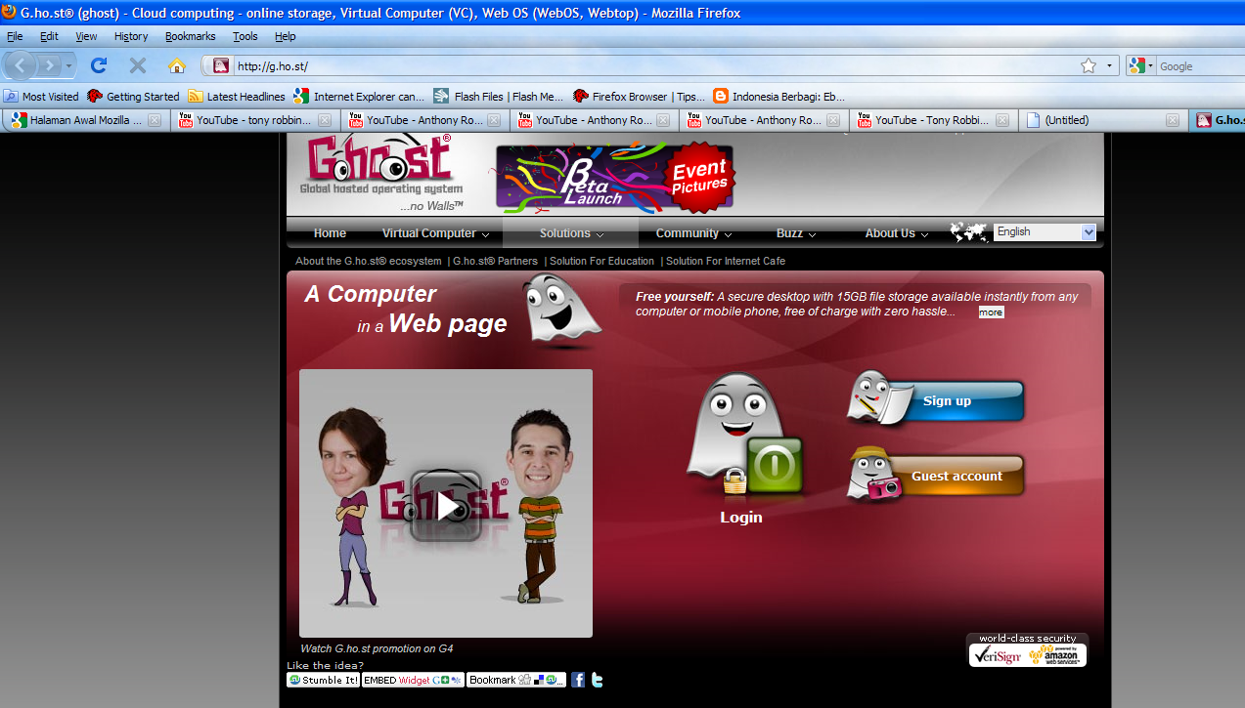
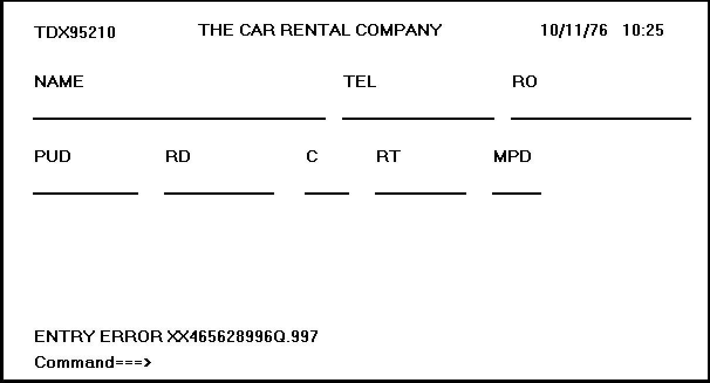
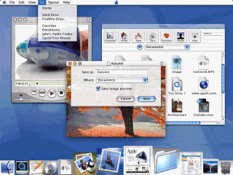
Text Based VS GUI VS Web UI
GUI
Text Based
Web UI

Slide 3
Interaction Framework
Manusia berinteraksi dengan komputer tentunya sangat komplek dan tidak mudah.
Interaction Framework
O
output
S U
System User
I
Input

Slide 4
Interaction Style
An interaction style is simply the method, or methods, by which the user and a computer system communicate with one another
Type of Interaction Style :
Command line
Menu-Based Interface
Form Fill in
Direct Manipulation
Anthropomorphic/Metaphors
Web Navigation
3D Environment
Zoomable interface
Natural Language

Slide 5
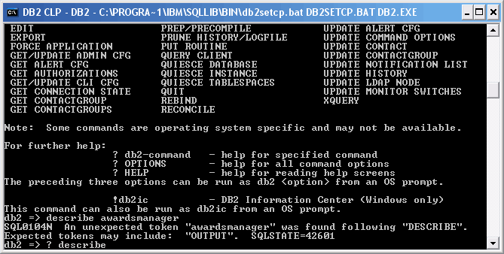
Interaction Style
Command line :
Merupakan interaction style paling awal dari teknologi computer
Powerfull for Advanced user
Complex Syntax
“Low error tolerant” sehingga bisa menyebabkan user frustasi

Slide 6
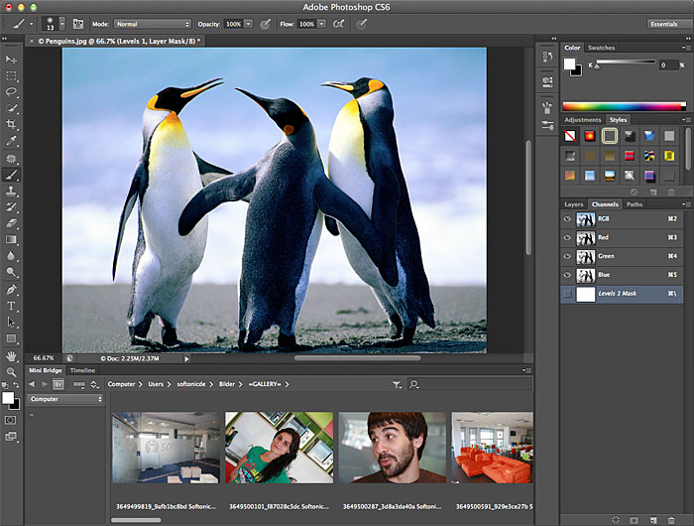
Interaction Style
Menu Selection
Trend UI saat ini di berbagai macam Aplikasi.
Utilize a person with much stronger Recognition.
Membantu bagi infrequent user.
Label Menu harus dimengerti dan memiliki arti yang jelas.

Slide 7
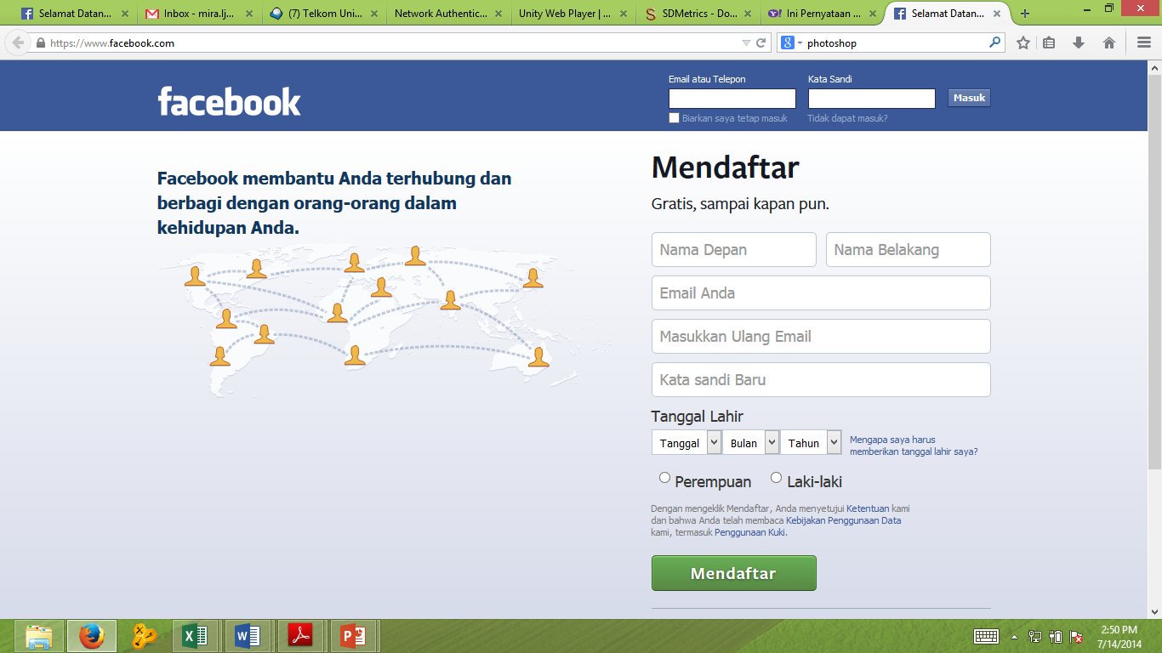
Interaction Style
Form Fill in
Sangat berguna untuk mengambil Informasi
Membutuhkan typing skill yang tinggi
Familiar dengan paper form di dunia nyata

Slide 8
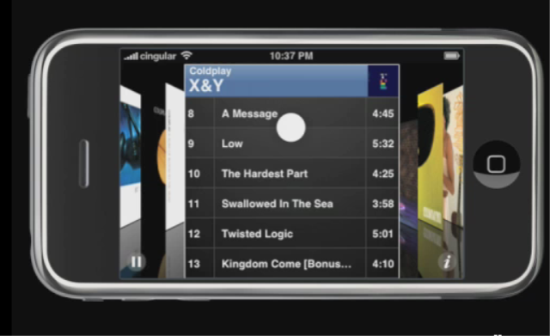
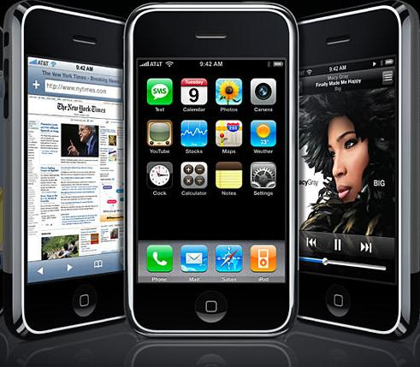
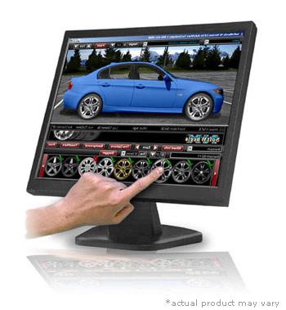
Interaction Style
Direct Manipulation
Memungkinkan User berinteraksi secara langsung bahkan memanipulasi objek yang tampil di layar

Slide 9
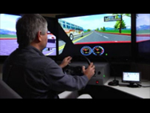
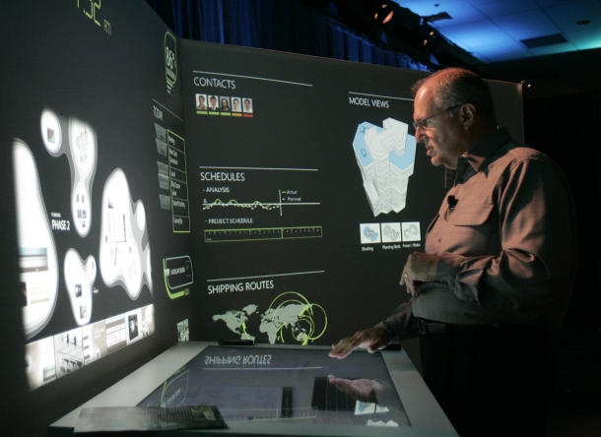
Interaction Style
Anthropomorphic
Sebuah antarmuka anthropomorphic mencoba untuk berinteraksi dengan orang-orang dengan cara yang sama seperti orang-orang berinteraksi satu sama lain. Ini mencakup dialog bahasa alami lisan, gerakan tangan, ekspresi wajah dan gerakan mata

Slide 10
Interaction Style
STYLE | ADVANTAGES | DISADVANTAGES
Command Line | Powerfull, Flexible, Appeals to expert user, Conserves screen space | Commands must be memorized, requires big learning effort, intolerant of typing errors
Menu Selection | Utilizes recognition memory, reduces interaction complexity, aids decision making process, minimize typing, aids casual users | Consumes screen space, may create complex menu hierarchies, may slow knowledgeable users
Form Fill in | Familiar format, simplifies information entry, requires minimal training | Consumes screen space, requires carefull and efficient design, does not prevent typing errors
Direct Manipulation | Faster Learning, easier remembering, exploits visual/spatial cues, easy error recovery, provides context, immediate feedback | Greater design complexity, window manipulation requirements, requires icon recognition, inefficient for touch typist, increased chance for screen clutter
Anthropomorphic | Natural | Difficult to implement

Slide 11
GUI VS WEB UI
KARAKTERISTIK SISTEM DIRECT MANIPULATION
Merupakan potret langsung dari kehidupan nyata
Object dan action selalu terlihat
Rapid and incremental Action with visible display of results
Incremental action are easily reversible

Slide 12
Graphics User Interface (GUI)
STYLE | ADVANTAGES | DISADVANTAGES
Direct Manipulation | Faster Learning, easier remembering, exploits visual/spatial cues, easy error recovery, provides context, immediate feedback, more attractive, easily augmented with text display, low typing req. | Greater design complexity, window manipulation requirements, requires icon recognition, inefficient for touch typist, increased chance for screen clutter, note always familiat, human comprehension limitation, may consume more screen space, hardware limitation.

Slide 13
Characteristics Of GUI
Sophisticated Visual Presentation
Pick and click interaction
A restricted set of interface solution
Visualization
Object orientation
Extensive use of a person’s recognition memory
Concurrent performance of function

Slide 14
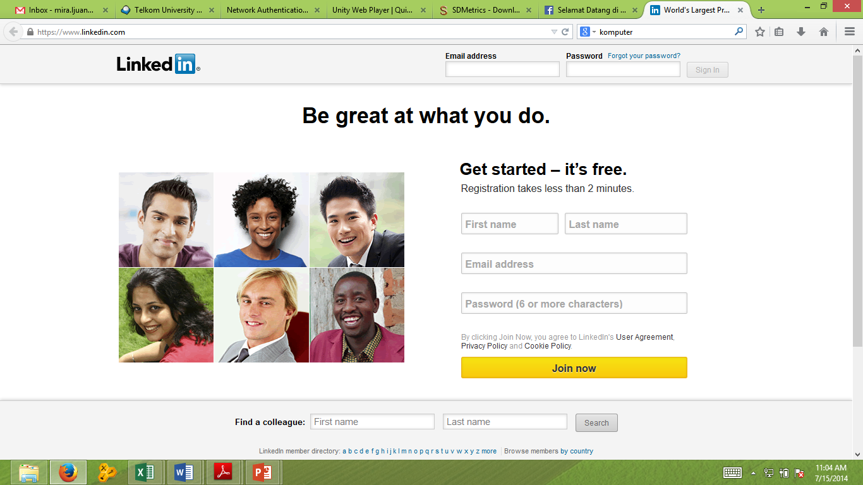
Web User Interface
Hal yang paling mendasar dalam Desain antarmuka Web itu adalah pada desain navigasi dan penyajian informasi. Dalam Web yang paling penting adalah Konten bukan Data
Web Page VS Web Application
More user Control

Slide 15
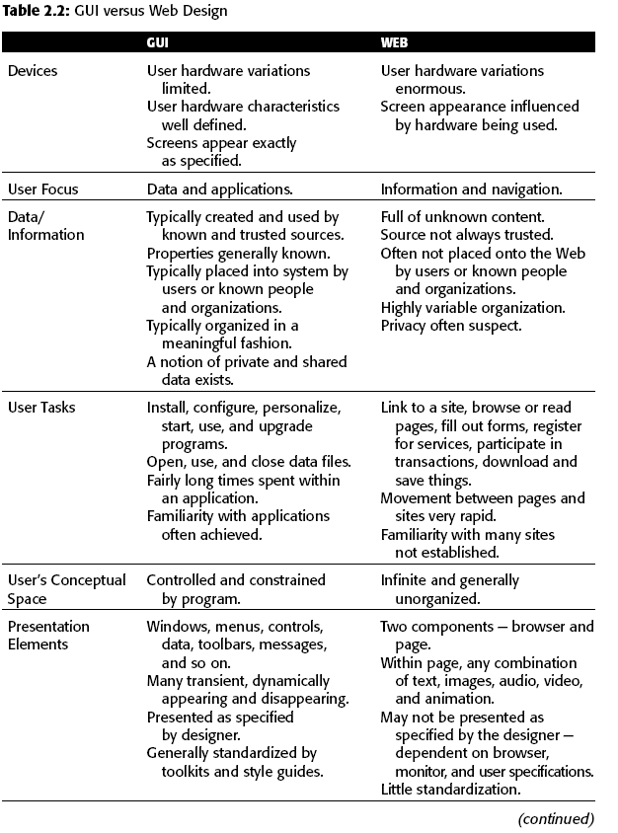
GUI VS WEB UI

Slide 16
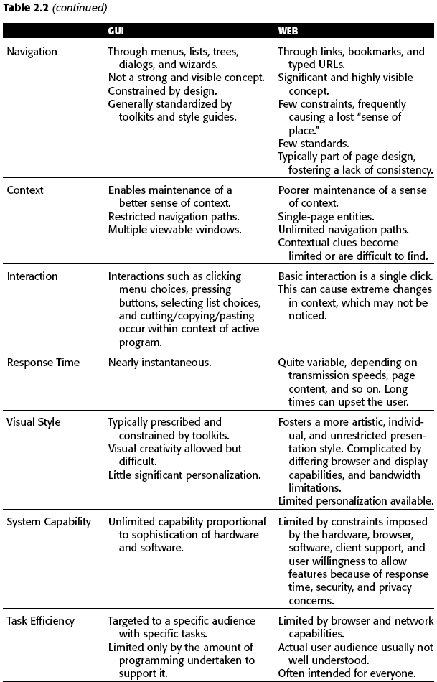
GUI VS WEB UI (cont)

Slide 17
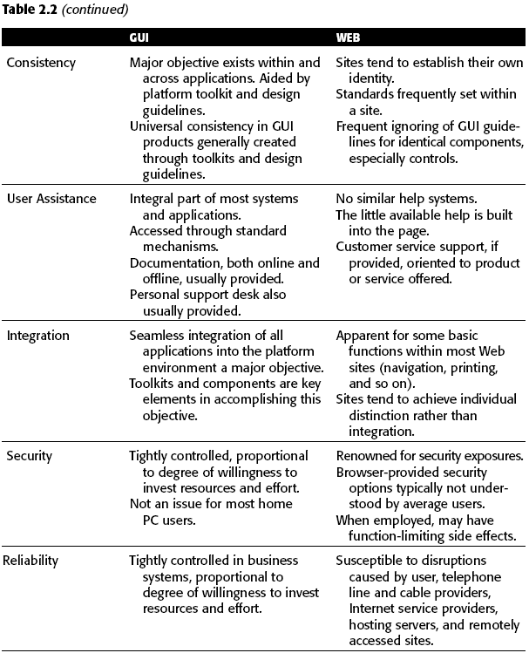
GUI VS WEB UI (cont)

Slide 18
The merging of graphical business systems and the web
Dimension | Web Application | Web Page | In the middle of continuum
The Nature of the relationship with the user | Users must use the program, Users must identifiy, themselves or login to be able to do anything, The program must be reliable, and system failure will be immediately noticed Work is remembered from earlier session | The system does not care who the user are, Login is required to simply give access to more information than would be received anonymously, System failure may not be noticed | Minimal information such as a credit card number or address is remembered
The Conversation style | The style is formal | The style is casual , informal and generic | The style is polite but friendly
The Nature of the interaction | A Large amount of data is entered, complex task are being performed, data is being created, manipulated and permanently stored | No data is entered or changed | A small amount of data is entered and possibly stored, Milestones, checkpoints, endpoints are expected and included
The Frequency of use | It is used daily, it is used for long period (4-8 Hour), it is used to help resolve emergencies | It is used only occasionally, it is used for only few minutes at a time, it is used to find out about something | It is used periodically or episodically

Slide 19
The merging of graphical business systems and the web (Cont.)
Dimension | Web Application | Web Page | In the middle of continuum
The Perceived distance of the provider | It is viewed as being local in origin, it is viewed as being controlled locally by a data administrator, the response time is fast | The origin is unknown, the origin is viewed as originating somewhere else in the country or overseas, the response time is slow | The origin cannot ascertained or doesn’t matter
Real Time interaction | Data is fed in real time, the information is critical, a delay is life-threatening, long reponses exist but users remain | Time is irrelevant, long response delay exist and cause users to exit | Response is near real time
How much help will users need? | Intense training programs and experience are needed to use and become experts | Every visit is one time session, minimizing or eliminating the need for help | A minimum amount of experience, training or help material is needed
The interaction style | The navigation is controled, controls are complex, the syntax is obejct:Action, there is little or no reversibility, drag and drop manipulation is expected, exit requires users to log off | The navigation is flexible and simple, controls are simple, no object selection is required, action are easily reversed using the back button, no drag-drop manipulation exist, single clicking links are used to navigate | The navigation is flexible, simple data collection exist, user exits by closing web browser
The Presentation style | The Style is subdue and serious | The style is colorfull, graphic, possibly animated, the control are obvious and self explanatory | The style is cooler but attractive
Follow standards | Platform standard compliance exists, the style resembles or matches GUI standard | Few Cross site standard are followed, only intra-site consistently exists | Some common pattern exists

