Slide 1
CSG2C3/ Interaksi Manusia dan Komputer (IMK)
Author-Nama dosen
KK SIDE
THE USER INTERFACE (UI) DESIGN PROCESS
Step 13 Organize and Layout Windows and Pages
Sumber: Galitz, Wilbert O. 2007. The Essential Guide to User interface Design: An Introduction to
GUI Design Principles and Techniques 3rd Edition. Wiley: Indianapolis.

Slide 2
Tujuan
Setelah mengikuti materi ini mahasiswa dapat:
Mahasiswa/i dapat mampu menerapkan pengaturan dan tataletak Windows dan halaman web yang sesuai dan bermakna.

Slide 3
Opening
Mempercepat Pemahaman Informasi
Pengaturan/ Pengorganisasian Layout windows dan halaman web yang baik
Mempercepat Proses Eksekusi Task dan fungsi
Meningkatkan User Acceptance

Slide 4
Our Goal
Organizing and laying out graphical and web screens to encourage quick and accurate information comprehension and control execution
Organizing Meaningfully and efficiently
Creating Grouping
Providing Allignment and balance

Slide 5
General Guidelines (Review step 3)
Amount of information
To much is confusing, to little is inefficient
Proportion of information to more than 30-40% of the window entire area
Flow
Provide ordering that logical, sequencial, and rhythmic
Maintain a top down, left to right flow
Navigation
Efificiency, minimize cursor and pointer travel, minimize hands travel of user from mouse to keyboard
Visually pleasing composition
Leave sufficient margin around all screen elements and between elements and the screen border
Count the tabs, count the “click”
Consistency
Balance, grouping and alignment
Adequate use of white space
Proper Emphasis of element
Provide consistency with user experiences and cultural convention
Provide consistency on operational and navigational procedure
Consistency on presentation
Critical, important, secondary, peripheral

Slide 6
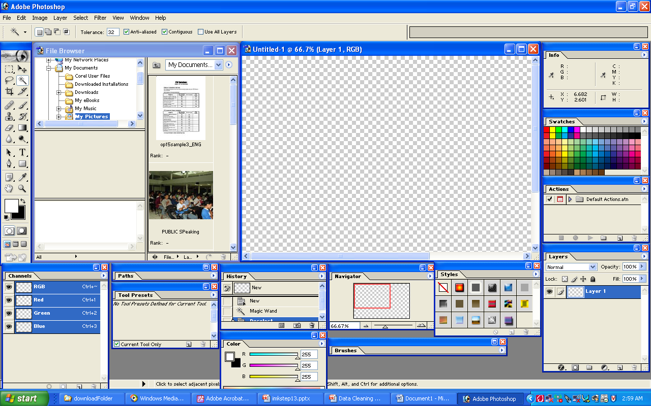
Bagaimana menurut anda ketika tampilan awal photoshop adalah seperti ini??
Notes:
Too many, confusing
Smua fitur ditampilkan ➔ seharusnya yang ditampilkan adalah yang dibutuhkan saja
Letak fungsi tidak dikelompokkan sesuai domainnya….
Area kerja jadi terbatas….

Slide 7
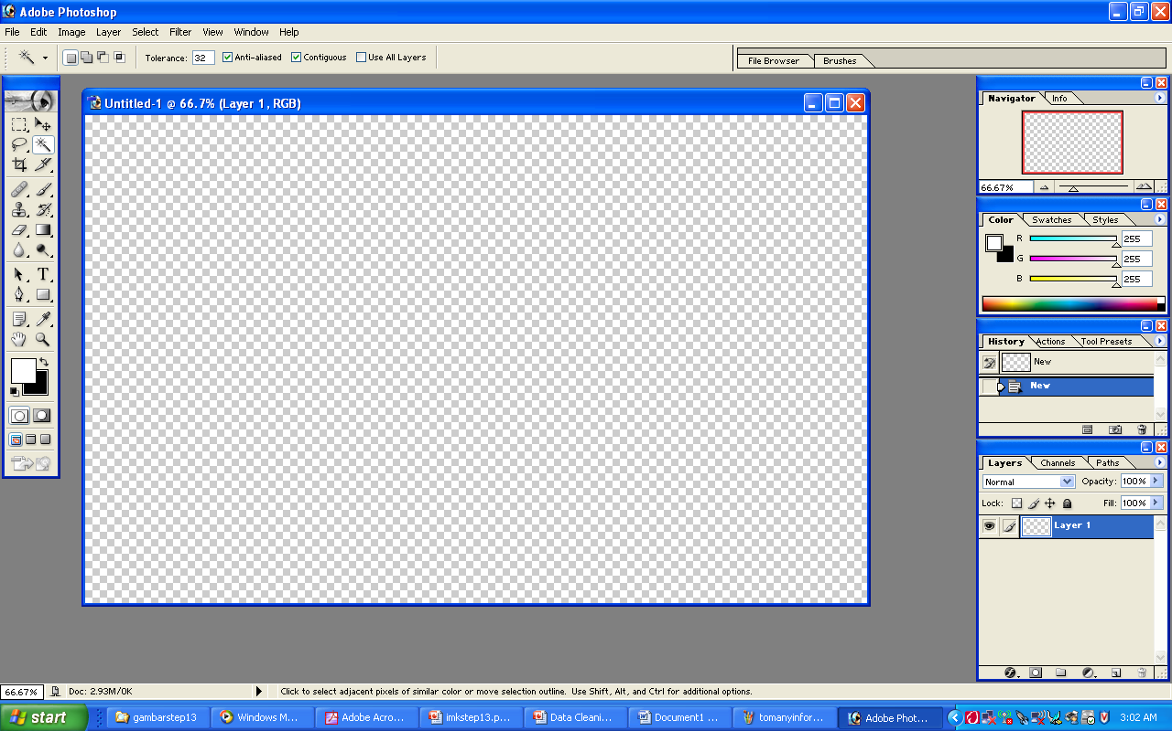
Bagaimana menurut anda ketika tampilan awal photoshop adalah seperti ini?? BANDINGKAN!!

Slide 8
Organization Guideline (Creating Grouping)
General
Provide grouping of associated elements
White Space
Headings
Provide section heading and subsection heading for multiple control grouping
Provide adequate separation of grouping through the use of white space
Leave adequate space around groups or related control, between grouping and windows border
The space between grouping should be greater than the space between fields within a grouping
Provide heading that meaningfully and concisely describer the nature of the group of related field
Borders
Enhance grouping through incorporation of borders around element of single control, groups of a related control or field
Individual control border should be visually differentiable from border delineating groupings of field or control
Do not place border around command button
Do not place individual field or control border around single entry filed, single list box, single combination boxes, single spin boxes, single siliders

Slide 9
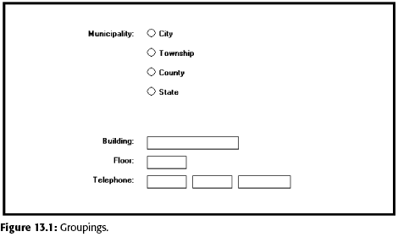
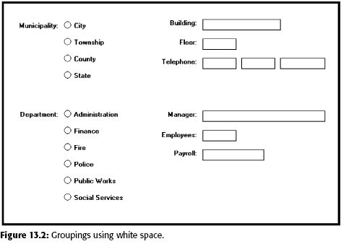
Organization Guideline (Creating Grouping)

Slide 10
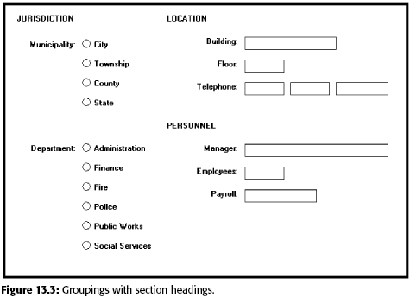
Organization Guideline (Creating Grouping)

Slide 11
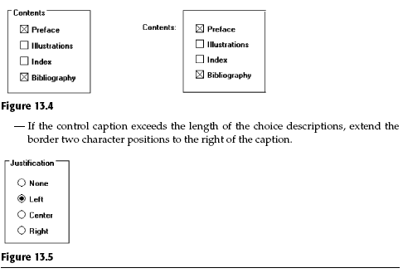
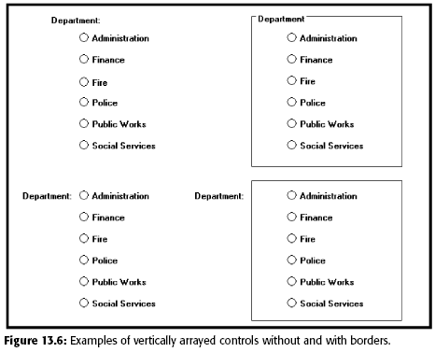
Organization Guideline (Creating Grouping)

Slide 12
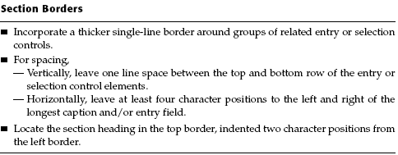
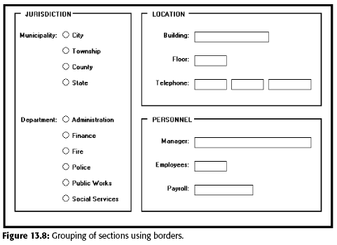
Organization Guideline (Creating Grouping)

Slide 13
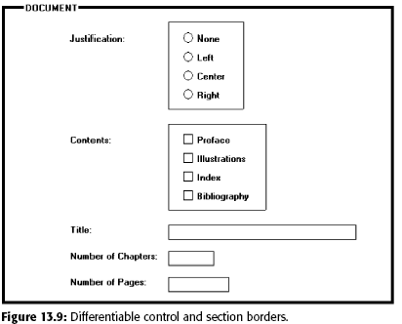
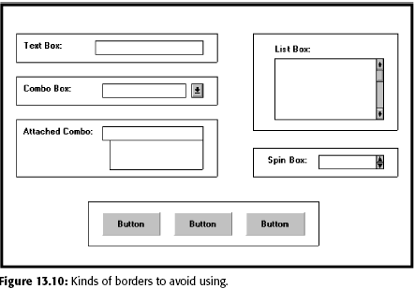
Organization Guideline (Creating Grouping)

Slide 14
Web Page Guidelines
General
Element
To keep pages simple, restrict the number of distinct functional element on a page, element include such tittle, navigation bar, textual link to major site area, textual content, graphics and page footer
Layout Grid
Establish a standard layout grid
Size
Efficient
Logical and consistent
Self explanatory
Scannable
Proper Balance
Consistency in every page
Better alignment and visual connection between element
Page Length: Minimize page length, restricting it to two or three screens of information
Anticipate Page Breaks
Horizontal scrolling: Layout page so horizontal scrolling is never necessary
Notes:
GENERAL:
Efficient. A page will be more powerful if more is said with less. Every element of
the design must support the goal of the message being presented. Eliminate all
superfluous elements. Avoid clutter that prevents people from finding what they
want. Exercise extreme care in using decorative elements.
Logical and consistent. Locate important page elements in consistent locations on
all pages. Alogical and consistent layout of the site and its pages will enable people
to quickly find what they are looking for. As said earlier in this book, people
develop expectations for how to find different types of information and how to
perform particular tasks. A layout that matches a person’s expectations speeds
learning and enables prediction of where to find things and how to do things.
Illogical and inconsistent structures lead only to user frustration.
Self-explanatory. Each page should be self-explanatory, giving a clear indication of
what Web site it belongs to and where it fits within the structure of the Web site’s
information space. Present the proper information, and arrange it, so users
always know where they are. Remember, most pages can be accessed from outside
the site.
Scannable. Allow people to easily scan a page and select relevant and useful information.
To foster scannability, include headings that accurately reflect the content
of text. Also create short paragraphs and use simple bulleted lists (complex bullets,
such as diamonds and fingers, may create unnecessary visual noise). Avoid
the use of too many links and use plenty of white space.
Proper balance. Always strike a proper balance between textual information,
graphics and navigation links. Apage’s elements must balance, interact with, and
support each other. As mentioned earlier, studies show people prefer textual content,
so do not clutter up the page with too many graphics, particularly at the top.
A large top graphic may push important textual content and navigation links off
the bottom of the page where they cannot be seen. Always make sure text is visible
first so people can start reading right away. Conversely, densely packed text
will be difficult to read. Long and detailed textual information can usually be relegated
to secondary pages.

Slide 15
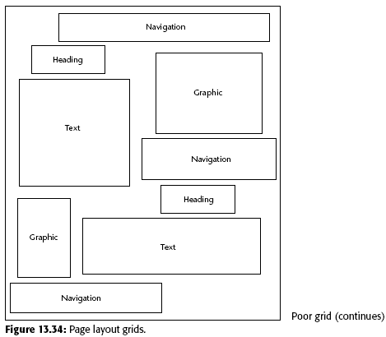
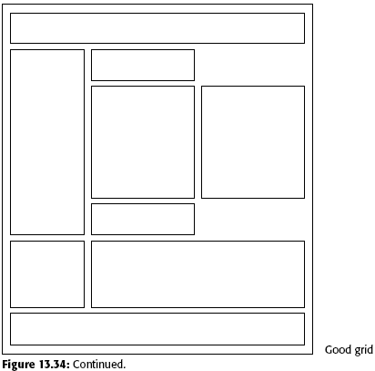
Grid Example (Poor VS Good)

Slide 16
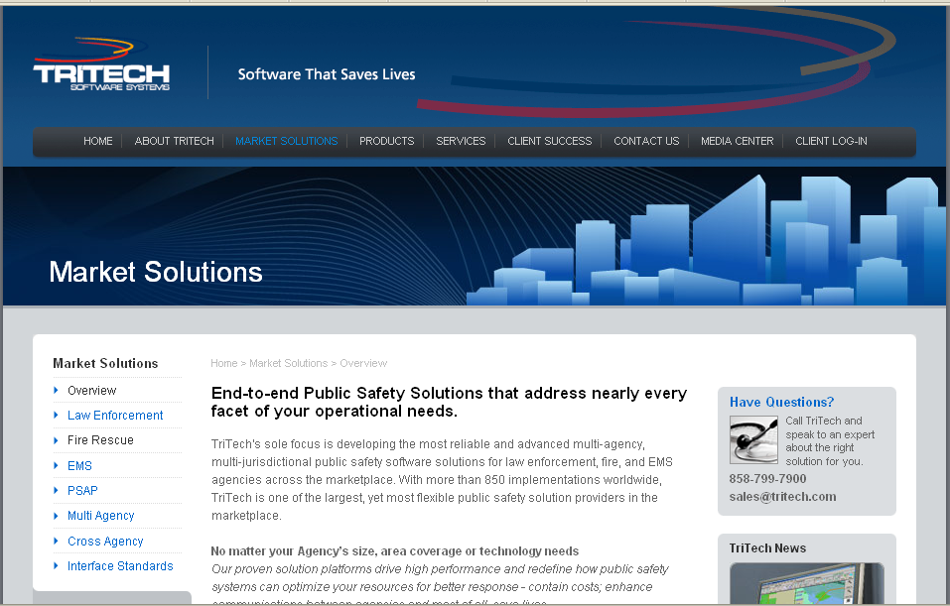
What do you think about this GRID??

Slide 17
What do you think about this GRID??

Slide 18
Web Page Guidelines (cont..)
Organization
Present information in different level of detail
Formatting
White Space
Platform
Important element at the top
Textual Line Length
Better alignment and visual connection between element
Anticipate the typical screen and resolution and specify an image save area of the screen that will always be visible to most viewer
Positioning
Reduced Complexity
Text
Multiple Audience

Slide 19
Web Page Guidelines (cont..)
Navigation element
Homepage
Limit to one screen
Provide a global navigation bar at the top of each page
Provide a local category or topical links navigation bar on the left side of a page
Optionally, provide a secondary navigation column on the right side of the page
Place minor illustrative, parenthetical, or footnote links at the end
For long pages provide “list of contents” link
Create a common and consistent theme
Never create pages without navigational options
Clearly identify the web site content and purpose
Element to include: Name or logo and tagline, web site name, brief desc of web site, Summary of the key informational content, Navigational links to most of the site of major section
Site map
Summary of the lattest news or promotion
Search facility

Slide 20
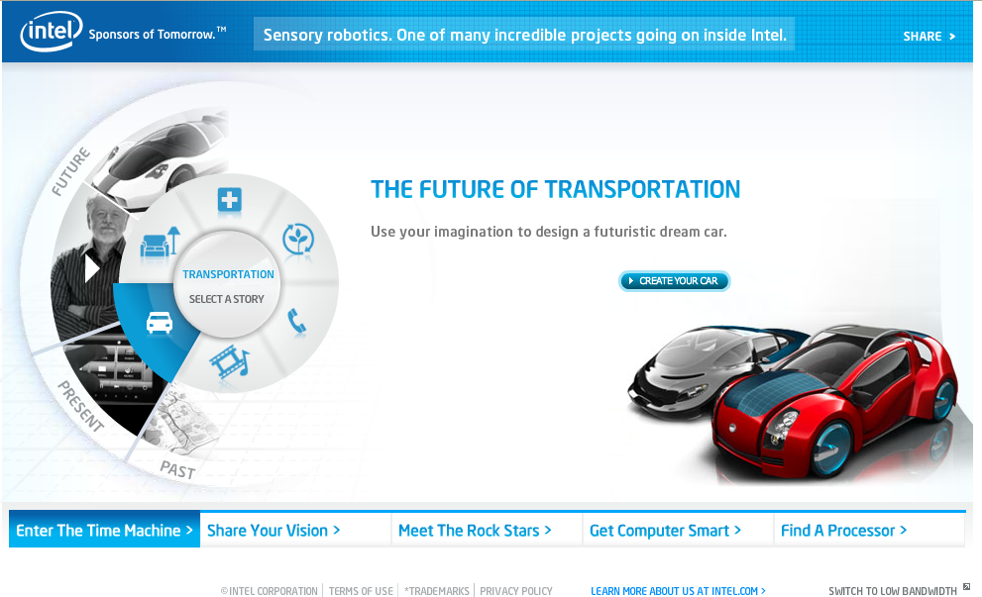

Slide 21
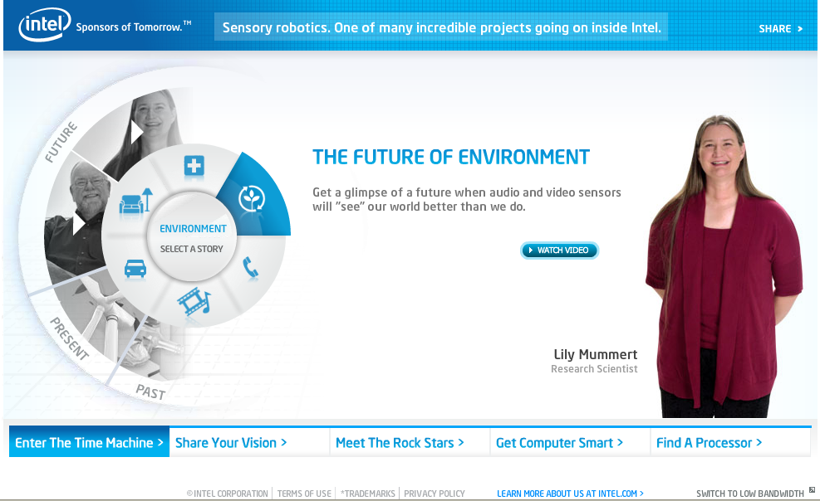

Slide 22
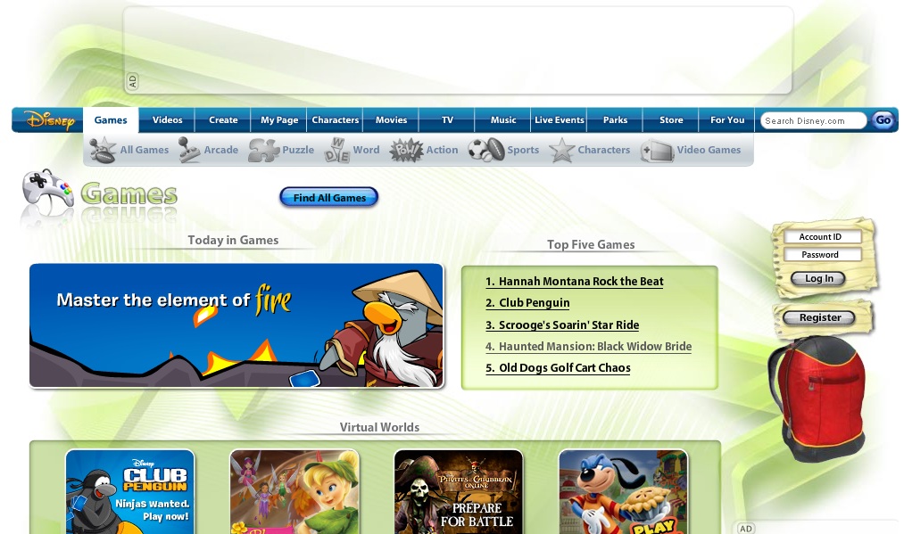
Scroll down!!

