Slide 1
CSG2C3/ Interaksi Manusia dan Komputer (IMK)
Tim Dosen IMK
KK SIDE
THE USER INTERFACE (UI)
DESIGN PROCESS
Step 11-12
Create Meaningful Graphics,
Icons, and Images &
Choose the Proper Colors
Sumber: Galitz, Wilbert O. 2007. The Essential Guide to User interface Design: An Introduction to
GUI Design Principles and Techniques 3rd Edition. Wiley: Indianapolis.

Slide 2
Tujuan
Setelah mengikuti materi ini mahasiswa dapat:
Mahasiswa/I mampu menerapkan Graphics, Icons, Images & Warna yang sesuai dengan kebutuhan
CSG2C3 - INTERAKSI MANUSIA DAN KOMPUTER

Slide 3
Today’s Topics
Part I
Icons
Part II
Color
Multimedia
Graphics
Color Uses
Possible Problems with Color
Color and Human Vision
Choosing Colors
Using Color to Avoid

Slide 4
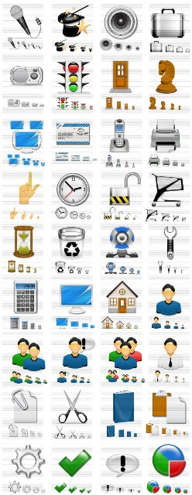
Icons
Icons are pictorial images most often used to represent objects and actions with which users can interact with or that they can manipulate.
Icons may stand alone on a desktop or in a window, or be grouped together in a toolbar.
A secondary use of an icon is to reinforce important information, such as a warning icon in a dialog message box.
Provide icons that are familiar, clear and legible, simple, consistent, direct, efficient, and discriminable.
Also consider the
  Context in which the icon is used.
  Expectancies of users.
  Complexity of task.

Slide 5
Kinds of Icons
Marcus (1984):
Icon. Something that looks like what it means.
Index. A sign that was caused by the thing to which it refers.
Symbol. A sign that may be completely arbitrary in appearance.
Rogers (1989):
Resemblance. An image that looks like what it means.
Ex. A book → a dictionary
Symbolic. An abstract image representing something.
Ex. A cracked glass → something fragile
Exemplar. An image illustrating an example or characteristic of something. Ex. A freeway exit picturing knife and fork → restaurant
Arbitrary. An image completely arbitrary in appearance whose meaning must be learned. Ex. Menu and sizing icons on screens
Analogy. An image physically or semantically associated with something. Ex. a wheel arrow full of bricks → move command

Slide 6
Some common icons. What do they stand for?
Hot Cold Fast Slow
Engine Oil Ammeter/ Generator Straight Turn
Automatic Variable Regulation Plus/ Positive Minus/ Neg

Slide 7
Max Number of Codes for Effective Human Differentiation
Encoding Method | Recom. Max. | Comments
Alphanumeric | Unlimited | High versatile. Meaning usually self-evident. Location time may be longer than for graphic coding.
Geometric Shapes | 10-20 | High mnemonic value. Very effective if shape relates to object or operation being represented
Size | 3-5 | Fair. Considerable space required. Location time longer than for colors and shapes.
Line Length | 3-4 | Will clutter the display if many are used.
Line Width | 2-3 | Good.
Line Style | 5-9 | Good.
Line Angle | 8-11 | Good in special cases (Such as wind direction)
Solid and Broken Lines | 3-4 | Good
Number of Dots or Marks | 5 | Minimize number for quick assimilation.

Slide 8
Max Number of Codes for Effective Human Differentiation ..
Encoding Method | Recom. Max. | Comments
Brightness | 2-3 | Creates problems on screens with poor contrast.
Flashing/ blinking | 2-3 | Confusing for general encoding but the best way to attract attention. Interacts poorly with other codes. Annoying if overused. Limit to small fields.
Underlining | No data | Useful but can reduce text legibility.
Reverse Polarity | No data | Effective for making data stand out. Flicker easily perceived in large areas.
Orientation (location on display surface) | 4-8 | -
Color | 6-8 | Attractive and efficient. Short location time. Excessive use confusing. Poor for the color blind.
Combinations of codes | Unlimited | Can reinforce coding but complex combinations can be confusing.

Slide 9
A Successful Icon
Looks different from all other icons.
Is obvious what it does or represents.
Is recognizable when no larger than 16 pixels square.
Looks as good in black and white as in color.
Choosing Icons Images:
Use existing icons when available.
Use images for nouns, not verbs.
Use traditional images.
Consider user cultural and social norms.

Slide 10
Concrete and familiar shapes
Visually & conceptually distinct shapes

Slide 11
Examples
Borders degrading
icon distinctiveness
Communication relationships
in icons
Avoid excessive detail
in icon design

Slide 12
Multimedia
The graphical flexibility of the Web permits inclusion of other media on a screen, including images, photographs, video, diagrams, drawings, and spoken audio.
On the one hand, the various media can be powerful communication and attention-getting techniques.
On the other hand, effective use of multimedia in design has been hindered by a lack of knowledge concerning how the various media may best be used, and a scarcity of applied design guidelines.
The objective is good interaction design, not “sparkle.”

Slide 13
Graphics
Use graphics to
  Supplement the textual content, not as a substitute for it.
  Convey information that can’t be effectively accomplished using text.
  Enhance navigation through
    Presenting a site overview.
    Identifying site pages.
    Identifying content areas.
Limit the use of graphics that take a long time to load.
Coordinate the graphics with all other page elements.
Graphics should not look like gratuitous decorations or banner ads.
Types of graphics (by purpose):
  Navigational. To identify links that may be followed
  Representational. To illustrate items mentioned in text
  Organizational. To relate items mentioned in text
  Explanative. To show how things or processes work
  Decorative. To provide visual appeal and emphasis

Slide 14
Graphics
Images: should convey their intended messages
Image maps: to provide navigation links to other content
Photographs/ Pictures: used when every aspect of the image is relevant
Video: to show things moving/ changing over time
Diagrams: to show the structure/ relationship of objects
Drawings: when selected parts need to be emphasized/ represented
Animation: to explain ideas involving a change in time/ position
Audition: as a supplement to text and graphics

Slide 15
Combining Mediums
Use sensory combinations that work best together
Closely integrate screen text with graphics
Both the visual and auditory information should be totally relevant to the task being performed
Visual and auditory textual narrative should be presented simultaneously, or the visuals should precede the narrative by no more than 7 seconds
To control attention, reveal information systematically
  Limit elements revealed to one item at a time and use sequential revelations for related elements.
Consider downloading times when choosing a media
Thoroughly test all graphics for
  Legibility
  Comprehensibility
  Acceptance

Slide 16
Learning Improvements for Various Media

Slide 17
Color
Color adds dimension, or realism, to screen usability.
Color draws attention because it attracts a person’s eye.
If used properly, it can emphasize the logical organization of information, facilitate the discrimination of screen components, accentuate differences among elements, and make displays more interesting and attractive.
If used improperly, color can be distracting and possibly visually fatiguing, impairing the system’s usability.

Slide 18
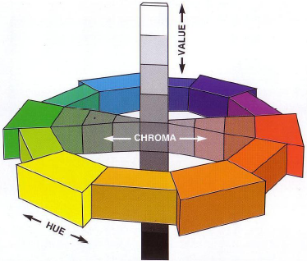
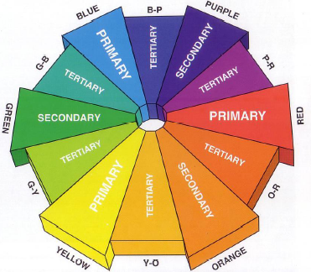
Color Dimensions

Slide 19
Color Uses
Use color to assist informatting a screen
  Relating or tying elements into groupings
  Breaking apart separate groupings of information
  Associating information that is widely separated on the screen
  Highlighting or calling attention to important information by setting it off from the other information
Use color as a visual code to identify
  Screen components
  The logical structure of ideas, processes, or sequences
  Sources of information
  Status of information
Use color to
  Realistically portray natural objects
  Increase screen appeal

Slide 20
Possible Problems with Color
High Attention-Getting Capacity
Interference with Use of Other Screens
Varying Sensitivity of the Eye to Different Colors
Color-Viewing Deficiencies
Color Connotations
Cross-Disciplinary and Cross-Cultural Differences

Slide 21
Common Color Connotations
COLOR | POSITIVE | NEGATIVE
Red | Active, Attractive, Dominating, Exciting, Invigorating, Powerful, Strong | Aggressive, Alarming, Energetic
Blue | Abstinent, Controlled, Deep, Dreamy, Faithful, Harmonious, Intellectual, Mysterious, Pornography, Rational, Sensible, Tenderness | Aggressive, Cold, Introverted, Melancholic
Blue-green or turquoise | Refreshing | Aloof, Cold, Self-willed, Sterile, Unemotional
Green | Calm, Close to nature, Conciliatory, Gentle, Harmonious, Optimistic, Refreshing, Strong willed | Envious, Inexperienced, Jealous
Yellow | Cheerful, Colorful, Extroverted, Full of fun, Light, Lively, Youthful | Cowardly, Exaggerated, Superficial, Vain
Orange | Alive, Communicative, Direct, Exciting, Joyful, Warm | Cheap, Intimate, Possessive, Vigorous
Purple | Luxurious, Royal, Serious | Sad
Derived from Gotz (1998) and Stone et al. (2005)

Slide 22
Color – the Research Shows
Color has been shown
  to improve performance (Kopala, 1981; Nagy and Sanchez, 1992; Sidorsky, 1982),
  to improve visual search time (Christ, 1975; Carter, 1982),
  to be useful for organizing information (Engel, 1980), to aid memory (Marcus, 1986b),
  to demarcate a portion of a screen (as opposed to lines or type font, Wopking et al., 1985)
Color:
  Does not improve performance (Tullis, 1981),
  Does not affect on reading text (Legge and Rubin, 1986),
  May impair performance (Christ and T, 1973; Christ, 1975),
  Is less important than display spacing (Haubner and B, 1983).
For simple displays, color may have no dramatic impact. As display complexity increases, however, so does the value of color. To be effective, color must be properly used.

Slide 23
Effective Foreground / Background Combinations

Slide 24
Choosing Colors for Web Pages
Color must always have a meaningful purpose
Use the browser 216-color palette
Presentation:
  Minimize the number of presented colors
  Always consider color in context
  Use similar or the same color schemes throughout
  For foregrounds: Use black or strong colors for text and headings
  For backgrounds: Use weaker contrasting colors such as off-white or light gray
  Use a uniform color in large areas
  The smaller the element, the more contrast is required between it and its background
  Larger images should use
    Flat, Web-safe colors
    Fewer colors than small images
  Select colors to be easily reproduced in black and white
Use default colors for links
Do not display non-link text in link colors
Test all colors

Slide 25
Uses of Color to Avoid
Relying exclusively on color
Too many colors at one time
Highly saturated, spectrally extreme colors together:
  Red and blue, yellow and purple
Low-brightness colors for extended viewing or older viewers
Colors in small areas, or for fine details.
Colors lacking contrast:
  Ex. yellow and white; black and brown; reds, blues, brown
Fully saturated colors for text or other frequently-read screen components
Pure blue for text, thin lines, and small shapes.
Non-opponent colors.
Red and green in the periphery of large-scale displays.
Adjacent colors that only differ in the amount of blue.
Single-color distinctions for color-deficient users.
Using colors in unexpected ways.
Using color to improve legibility of densely packed text.

